Slide 1
Basic Economic Ideas
Lecture 1: Objectives
to identify the basic economic problem of scarcity and its inter-related problems.

Slide 2
Aims/objectives
Consumers – maximize satisfaction, minimize spending
Firms – maximize profit by maximizing total sales revenue and minimizing cost
Government – maximize welfare
Rational consumer – maximize satisfaction, spend within limited income
Rational firm – maximize profit, min. cost

Slide 3
Problem of scarcity
Consumer have needs and wants
Consumer wants are unlimited
Factors of production/resources are limited
Scarcity refers to the excess of human wants over and above what can be produced to fulfill these wants

Slide 4
Basic Economic Problem
  ‘scarce resources in relation to unlimited wants’
  also referred to as problem of scarcity
  human wants are unlimited but resources are limited (scarce) i.e. the fundamental/basic problem from which all other problems arise.

Slide 5
Basic Economic Problem
  Problem of scarcity gives rise
  to 3 Inter-related problems
      What and how much to produce
      How to produce
      Whom to produce

Slide 6
What and how much to produce?
what to produce?
(cars or motorbikes)
also sometimes referred to as the problem of product mix
in what amounts/quantities
Notes:
This problem relates to what economists refer to as the allocation of resources

Slide 7
How to produce?
techniques to use
least cost method of production
labour intensive or capital intensive
sometimes referred to as the problem of factor combination – how resources are used for the best outcome

Slide 8
For whom to produce?
to meet the needs of society (majority) or individual groups/how many of each person’s wants are to be satisfied
sometimes referred to as the problem of distribution
Notes:
*There are different mechanisms available to solve this problem – physical rationing, allocation through the market mechanism, etc. – this raises another aspect of the problem of distribution, i.e. of income distribution.

Slide 9
Basic/fundamental economic problem – scarce resources relative to unlimited wants
Limited resources and unlimited wants leads to scarcity
Scarcity leads to choices – by weighing the benefits and cost: choice leads to max benefit and min. cost
Choices then, leads to opportunity cost – the next best alternative forgone
All economic agents face this fundamental economic problem

Slide 10
OPPORTUNITY COST
Scarcity necessitate us
to make choices
i.e. how to
allocate resources
among the competing uses.
CHOICE
Making a choice involves a trade off.
In choosing one option, we have to give up another
Opportunity cost
is measured in terms of the
next best alternative
foregone
the sacrifice of alternatives
is known as
Opportunity Cost

Slide 11
Basic Economic Problem
Economics defined
it is a study of social science, which deals with the allocation of scarce resources, which have alternative uses, to fulfill the objectives of economic agents

Slide 12
LECTURE 2
Objectives
To identify and explain the various factors of production and factor rewards
To identify and explain economic structures, positive and normative statements and scope of economics
To distinguish between free goods and economic goods , time dimensions

Slide 13
Basic Economic Problem
What are resources?
- inputs or factors of production
    - comprising of :
    - Land – rewarded by rental
    - Labour – rewarded by wages
    - Capital – rewarded by interest
    - Enterprise- rewarded by profit

Slide 14
Basic Economic Problem
Resources (cont’d) - Land
includes all natural resources or endowments on earth: gifts of nature
classified as:
- renewable resources – that which can be used and replaced e.g. fish stocks, water, forests
- non-renewable resources – that which once used can never be replaced e.g. oil, gold

Slide 15
Basic Economic Ideas
Resources (cont’d) – Labour
Includes all mental/intellectual capital and physical workforce of an economy
Also known as human capital
E.g. services of an accountant, teacher, or labourer

Slide 16
Basic Economic Ideas
Resources (cont’d) – Capital
manufactured stock of tools used in the production
of goods and services or
goods that are used in the production of other goods and services e.g. machines, factories.
fixed capital
- is the stock of factories, offices, plant and
machinery
- is fixed and will not be turned into a final product.
working or circulating capital
- is stocks of raw materials, semi-manufactured and
finished goods waiting to be sold.

Slide 17
Basic Economic Ideas
Resources (cont’d) : Entrepreneurship
i.e. the factor which organises all the other 3 factors into the production process for a profit.
performs 2 functions:
- combines, organises and coordinates the other 3 FOP’s in the production process to promote efficiency and an increase in output
- takes the risk of a profit or a loss (arises from a situation of uncertainty associated with the initiative/decision taken)

Slide 18
Factors of production, economic structure
Primary factors – land and labour
Secondary factors – capital and enterprise
Economic structure – how an economy is divided into a number of different sectors
  Primary sector – involved in the extraction of natural resources
  Secondary sector – involved in the conversion of input to output e.g.. Manufacturing and construction
  Tertiary sector – support, service based sector
  Quaternary sector – knowledge based economy, provision of information (R & D, ICT)

Slide 19
Basic Economic Problem
Production and consumption
The limited resources (land, labour, and capital) are combined in a production process by the factor enterprise to meet the unlimited wants of consumption (by consumers, producers and governments).
- Wants are faced with the problem of scarcity - choices need to be made.
Notes:
Wants of different parties varies over a scale of preferences according to the culture, experiences, upbringing and time period.

Slide 20
Positive & Normative Statements
Positive statement
is based on empirical or actual evidence/facts
can be proven as correct or incorrect, for e.g. ‘a rise in
  price will lead to a fall in the quantity demanded.
Normative statement
contains a value judgment/opinion
cannot be verified by resort to investigation or research,
for e.g. ‘The govt has a duty to protect the incomes of
everybody in society’.
Notes:
* Positive economics is also called descriptive economics because it attempts to describe as accurately as possible what is there; in normative economics, we voice our opinions, so, words such as “should” or “ought” are generally part of such statements.

Slide 21
Basic Economic Problem
  Scope of Economics:
* Micro - deals with activities and decisions of individual units or groups e.g. consumer, household, or firm (for e.g. demand by consumers)
* Macro – deals with the entire nation or economy as a whole for e.g. aggregate demand

Slide 22
Ceteris Paribus
Latin term to refer to a situation where ‘other things remain equal’.
This is to simplify an actual situation by assuming that apart from a single change of circumstances, everything else is unchanged.

Slide 23
Free goods vs. economic goods
Free goods – not produced from scarce resources, abundant in supply, zero opportunity cost. E.g. include sunshine, air and sea water
Economic goods – produced from scarce resources, limited in supply, price to pay, involves opportunity costs. Also known as private goods

Slide 24
Time dimension
Short run – time period where a firm can change some but not all factors of production
Long run – time period when all factor inputs are variable
Very long run – where not only are all factors of production variable, but all other key inputs (technology, Gov. regulation & social considerations ) are also variable

Slide 25
Lecture 3: Production possibility curve (PPC)
Objectives
  To define PPC and state its assumptions
  To identify and explain the different production possibilities in the short run
  Causes of long run shifts
  To explain the uses of PPC

Slide 26
Basic Economic Problem
Resources have alternative uses:
Choices involve opportunity cost
Opportunity cost is the next best alternative foregone as a result of making a choice
applies to both production decisions and consumption decisions

Slide 27
Production Possibility Curve
also referred to as:
Production Transformation Curve
Production Possibility Frontier/Boundary
What is a PPC?
- is a locus of different combinations of maximum output that can be produced by a country/firm when all resources are fully and efficiently utilised.

Slide 28
Production Possibility Curve
- PPC illustrates how problem of scarcity is overcome by making choices.
- choices made on what to produce
(e.g. a choice has to be made to produce either consumption goods or capital goods)
- choices involve opportunity cost.

Slide 29
Production Possibility Curve
Assumptions made in the PPC:
- only 2 goods produced
- level of technology fixed
- resources are fully utilised
- factors are fixed in amount

Slide 30
Production Possibility Curve
Capital
goods
* Production of one good mean another good is foregone
-ve slope: limited resources/scarcity, opportunity cost
Concave: increasing opp.cost
Points on the curve: choices
PPC
0
Consumer
goods

Slide 31
Production Possibility Curve
Production Possibilities – short run
- production outside PPC
- production inside PPC
- production at margin/ on the PPC

Slide 32
Production Possibility Curve
Production possibilities
Manufactured
goods
d
*
*
b
*
c
*
a
0
Agricultural
goods

Slide 33
Production Possibility Curve
Production possibilities:
a, b, & c - achievable
d - not achievable
b & c - full employment
(production at margin)

Slide 34
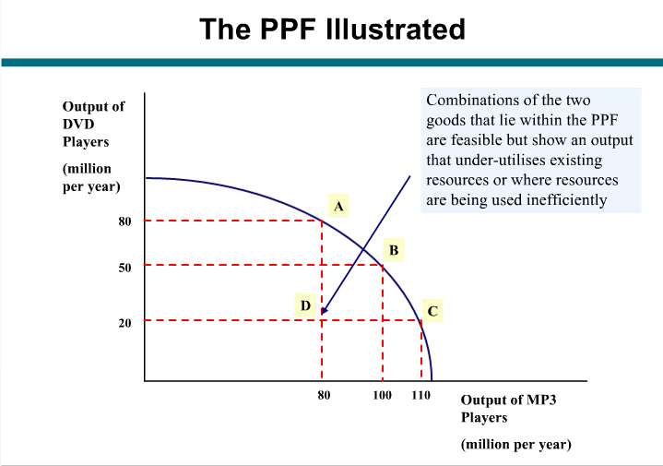
Basic Economic Ideas - PPF

Slide 35
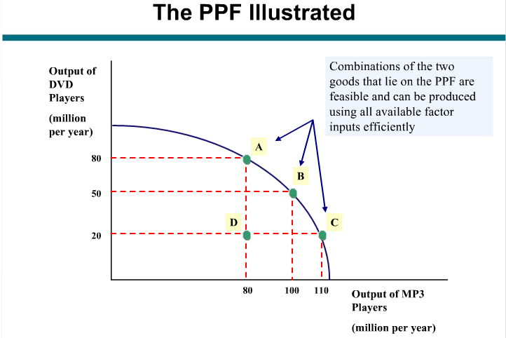
Basic Economic Ideas - PPF

Slide 36
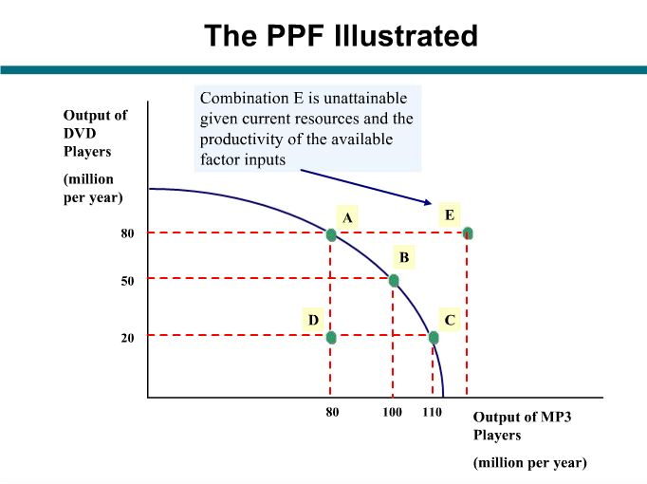
Basic Economic Ideas - PPF

Slide 37
PPC
Shapes of PPC: reflected by the type of opportunity cost
- increasing opportunity cost (concave)
- decreasing opportunity cost (convex)
- constant opportunity cost (linear)
Slope of PPC - reflects the opportunity cost , downwards slope due to limited/scarce resources: more of one goods means less of the other

Slide 38
Production Possibility Curve
Increasing Opportunity Cost
Manufactured
goods
15
The amount of good Y forgone increases as an extra unit of good X is produced
14
12
9
5
0
1
2
3
4
5
Agricultural
goods
Notes:
* If more and more of manufactured goods have to given up to increase just one more unit of an agricultural good, than the factor is more suited to the production of manufactured good than agricultural goods.

Slide 39
PPC
Decreasing Opportunity Cost
Manufactured
goods
The amount of good Y forgone decreases as an extra unit of good X is produced
0
Agricultural
goods
Notes:
* In order to produce one more agricultural good, less than one unit of manufactured good needs to be foregone.

Slide 40
PPC
Constant Opportunity Cost
Manufactured
goods
The amount of good Y forgone is constant as an extra unit of good X is produced
0
Agricultural
goods
Notes:
To produce an additional unit of agricultural good, a unit of manufactured good has to be foregone.

Slide 41

Making a fuller use of resources ( short run changes)
Economic recovery/moving towards full employment : actual growth (short run)
x
Production inside
the production
possibility curve
y
Food
v
O
Clothing

Slide 42
Production Possibility Curve
Shifts in PPC – types:
- Pivot shifts
- Parallel shifts

Slide 43
Production Possibility Curve
Shifts in PPC – causes:
  changes in quantity of resources
    population growth, discovery of new raw material, capital investment
  changes in quality of resources
    Productivity of labour rises, higher skilled workforce
    advancement in technology,
  * Changes the ability/potential to produce goods in the long run: more of both goods are produced

Slide 44
Production Possibility Curve
Horizontal Pivot Shift
Agro
sector
Y
Non-agro sector
O
A
B

Slide 45
Production Possibility Curve
Vertical Pivot Shift
Agro sector
U
T
S
U
Non-agro sector
O
X
XX

Slide 46
Production Possibility Curve
Pivot Shifts:
* horizontal – technological advancement in non-agriculture sector
* vertical - technological advancement in agriculture sector

Slide 47
Production Possibility Curve
Parallel Shifts: inwards and outwards
A’
Potential growth: long run
A
A”
O
B”
B
B’

Slide 48
Production Possibility Curve
Parallel shifts
* outwards – increase in quantity/quality
of resources economic growth – for
e.g. technological advancement in
whole economy
* inwards - for e.g. depletion of resources

Slide 49
Production Possibility Curve
Uses of PPC:
  in relation to microeconomics:
    Efficiency
    Opportunity cost
    Scarcity, choice
  In relation to macroeconomics:
    Unemployment/full employment
    Economic growth/recession
    Standard of living
-

Slide 50
Production Possibility Curve
Consequences of producing more capital goods than consumer goods: investment
  increase in future living standards
  fall in current standard of living
  if production is on the PPC,
    total current output remains the same
    future total output is higher
Notes:
Consequences for developing economies – they are characterised by low living standards – in order to achieve higher economic growth, need to increase their capital stock, i.e. divert resources from current consumption (production of consumer goods to capital goods), however some resources need to be diverted to production of consumer goods to keep expanding population alive.

